Slide 1
NetApp Tech Day
Ariovaldo Veiga de Almeida
ari@netapp.com
Senior Systems Engineer – NetApp Brasil

Slide 2
Visão Geral sobre a NetApp
FY11: $5.1B
$5B
Amplo portfólio de soluções
Serviços profissionais abrangentes
Suporte global
Parceiros líderes na indústria
150+ escritórios no mundo
11.000+ funcionários
Fortune 1000, S&P 500, NASDAQ 100
$4B
$3B
$2B
$1B
04
05
06
07
08
09
10
11

Slide 3




Rely on NetApp Storage Solutions
300 million active accounts
100–200 million users
200 million active users
290 million reservations/month
46 million users
1.3 million e-mail accounts
“Music Service”
“Social Network”
Over 1 billion consumers receive cloud services today
from customers of NetApp
Notes:
Already, more than 1 billion consumers receive cloud services built on a NetApp foundation.
If you add up the number of people using cloud services that are running on NetApp today, the number exceeds a billion users:
Yahoo! e-mail: 300 million active accounts
Leading music download service: 100-200 million users
World’s fastest-growing social media site: 200 million active users
Navitaire: 290 million reservations/month
Photobucket : 46 million users
France Telecom: 1.3 million e-mail accounts
And we’re not even counting users of:
SAP by design Oracle on Demand
Intuit Quickbase Rackspace
Intuit apps Azaleos
“Music” backup” Iron Mtn Digital
CSC Perot Systems Backup
EDS Connected T-Systems
BT
Joyent AT&T
CSC IBM Hosting
Unisys Telstra* on their internal private cloud
Sprint* and their internal private cloud BMW* internal private cloud
Siemens* internal private cloud
Oracle on Demand

Slide 4
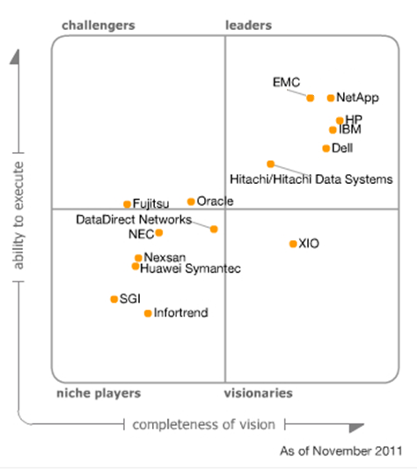
Gartner Midrange & High End
Modular Disk Array Magic Quadrant
Source: Gartner, Inc. Nov 2011
Roger W. Cox, Jimmie Chang, Pushan Rinnen, Stanley Zaffos
Magic Quadrant for Midrange and High-End Modular Disk Arrays
This Magic Quadrant was published as part of a larger research note and should be evaluated in the context of the entire report. The report is available upon request from NetApp.
The Magic Quadrant is copyrighted Nov 15, 2010 by Gartner, Inc. and is reused with permission. The Magic Quadrant is a graphical representation of a marketplace at and for a specific time period. It depicts Gartner's analysis of how certain vendors measure against criteria for that marketplace, as defined by Gartner. Gartner does not endorse any vendor, product or service depicted in the Magic Quadrant, and does not advise technology users to select only those vendors placed in the "Leaders" quadrant. The Magic Quadrant is intended solely as a research tool, and is not meant to be a specific guide to action. Gartner disclaims all warranties, express or implied, with respect to this research, including any warranties of merchantability or fitness for a particular purpose.
NetApp Confidential - Limited Use
4
Notes:
https://rogerluethy.wordpress.com/2011/11/28/gartner-storage-magic-quadrant-2011/

Slide 5
Gartner Magic Quadrant
Midrange and High-End NAS Solutions
Source: Gartner, Inc. March 2011
Pushan Rinnen, Robert E. Passmore, Roger W. Cox
Magic Quadrant for Midrange and High-End NAS Solutions
This Magic Quadrant was published as part of a larger research note and should be evaluated in the context of the entire report. The report is available upon request from NetApp.
The Magic Quadrant is copyrighted March 15, 2011 by Gartner, Inc.
and is reused with permission. The Magic Quadrant is a graphical representation of a marketplace at and for a specific time period. It depicts Gartner's analysis of how certain vendors measure against criteria for that marketplace, as defined by Gartner. Gartner does not endorse any vendor, product or service depicted in the Magic Quadrant, and does not advise technology users to select only those vendors placed in the "Leaders" quadrant. The Magic Quadrant is intended solely as a research tool, and is not meant to be a specific guide to action. Gartner disclaims all warranties, express or implied, with respect to this research, including any warranties of merchantability or fitness for a particular purpose.
challengers
leaders
NetApp
EMC
IBM
ability to execute
Oracle
Hitachi/Hitachi Data Systems
BlueArc
Panasas
HP
LSI
Symantec/Huawei Symantec
Scale Computing
Pillar Data Systems
niche players
visionaries
completeness of vision

Slide 6

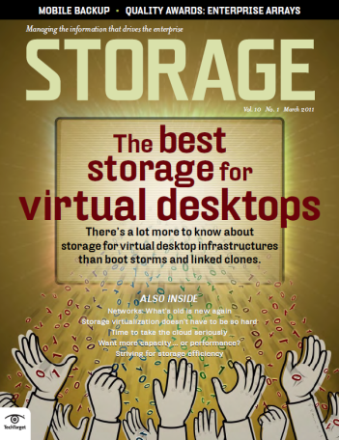
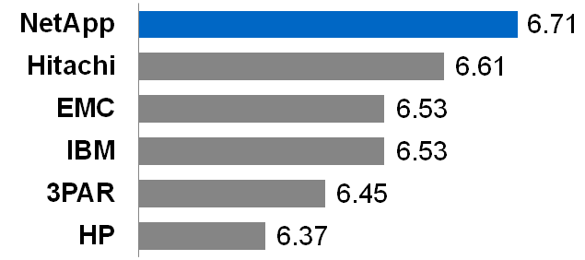
Quality Awards Enterprise Storage
NetApp #1 in
Initial product quality
Product features
Technical support
Customer satisfaction
Knowledgeable sales
Overall Rankings: Enterprise Arrays
Storage Magazine: Vol. 10 No 1, March 2011, “Quality Awards: Enterprise Storage”
Notes:
Our customers notice our dedication to their success. For the second year in a row, readers have voted NetApp the #1 vendor of enterprise arrays in their annual storage quality award survey. Readers selected NetApp as the best in product quality, features, technical support, customer satisfaction, and for having a knowledgeable sales force.

Slide 7










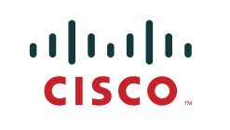





















Leaders Are Taking Action
Energy
Financial
Tech
Government
Healthcare
Information
Telco
Hosted Services
Notes:
7
Our customers operate in a broad range of industries and geographies and they each have diverse needs, challenges, and business goals.
Telstra has standardized on NetApp in a “storage as a service” model where all their applications access a pool of more than 18PB of shared storage resources.
Siemens has 18+PB supporting a broad range of activities, including 200,000 Exchange seats.
T-Systems runs its IT-as-a-Service offerings on NetApp for major companies like BMW, Heineken, and Shell. In fact, Shell is outsourcing 100% of its IT to T-Systems.
At Oracle we support more than 1600 independent database environments, 500 of them mission-critical ones for its customers. Oracle broadly standardized on NetApp for its own data center operations as well as its On-demand business.
At Yahoo, more than 100 PB and a deep partnership with NetApp helps them keep pace with rapid growth of over 300 million email inboxes. This relationship began with the very first inbox on Rocketmail and has continued uninterrupted since.
Some of the world’s biggest and most successful banks rely on NetApp. Media companies push the limits of imagination and performance with the help of NetApp. Southwest Airlines, Catholic Healthcare West, Thomson Reuters, Cisco, Navitaire, BT, Telstra, France Telecom, AT&T, Verizon and many more customers have broadly standardized on NetApp in the heart of their data centers and at the foundation of their business.
Customers large and small benefit from the increased efficiency and flexibility they get when they choose NetApp as the foundation for their IT infrastructure.
Transition to next slide:
Whether large or small, the efficiency and flexibility that a NetApp foundation provides directly impacts business outcomes.

Slide 8
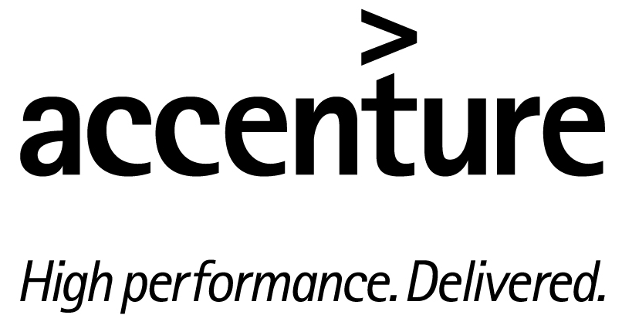


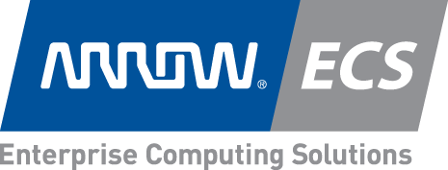
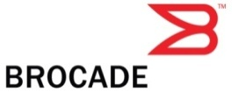

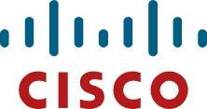















NetApp Partnerships = High-Value Solutions
Reduce risk
Shorten time to deployment
Save money through increased data center efficiency
Protect current investments
Grow and adopt new technologies
Strategic and Implementation Partners
Notes:
We have close service partnerships with industry leaders like Oracle, Microsoft, Cisco, VMware, SAP, IBM, and Symantec, with whom we can deliver integrated solutions that span not only the products, but also people and processes that work together to help maximize the results you get.
Some of the ways we collaborate in professional services include:
Consulting Agreements that facilitate our ability to call on other company’s experts for joint design work and delivery
Jointly developed best practices and methodologies to help ensure high-quality solution deployment
Joint support agreements with our strategic partners, so any issues are resolved quickly without finger pointing.
We also have Implementation partners, these may be distributors or Regional SIs. You can customize this slide to the customer’s situation by adding local partners.
The benefits to customers of the NetApp approach to Services are: reduced risk and a shorter time to deployment for new solutions (since we do them everyday), advice on how to architect for efficiency in the data center and how to improve utilization of current investments and help on adopting new technologies.

Slide 9















































Alguns Clientes no Brasil
Telco & Mídia
Financeira
Governo
Indústria e Varejo
Energia
Cloud
9
Notes:
9
Our customers operate in a broad range of industries and geographies and they each have diverse needs, challenges, and business goals.
At Oracle we support more than 1600 independent database environments, 500 of them mission-critical ones for its customers. Oracle has broadly standardized on NetApp for its own data center operations as well as its On-demand business.
At Yahoo, 80 PB and a deep partnership with NetApp helps them keep pace with rapid growth of over 300 million email inboxes. This relationship began with the very first inbox on Rocketmail.
Telstra has standardized on NetApp in a “storage as a service” model where all their applications access a pool of more than 18PB.
Siemens has 18+PB supporting a broad range of activities, including 200,000 Exchange seats.
T-Systems runs IT-as-a-Service on NetApp for major companies like BMW, Heinekin, and Shell. In fact, Shell is outsourcing 100% of its IT to T-Systems.
Some of the world’s biggest and most successful banks rely on NetApp.
Media companies push the limits of imagination and performance with the help of NetApp.
Southwest Airlines, Catholic Healthcare West, Thomson Reuters, Cisco, Navitaire, BT, Telstra, France Telecom, AT&T, Verizon and many and many more customers have broadly standardized on NetApp in the heart of their data centers and at the heart of their business.
Transition to next slide:
I’ve talked about some of the challenges we can help with and what customers are doing with NetApp solutions. I’d like to transition now and talk about the value we offer and what sets us apart

Slide 10
Soluções de Storage

Slide 11
A History of Inovations
2011
Unified (SAN / NAS) storage at Scale (Up / Out)
2009
Unified SAN (FCoE / FC / iSCSI) and NAS (NFS / CIFS) storage
2007
Storage Deduplication
2006
Scalable grid storage
2005
Thin provisioning and virtual cloning
2004
RAID-DP™ improved disk resiliency
2003
Unified SAN (FC / iSCSI) and NAS (NFS / CIFS) storage
2002
Unified SAN (FC) and NAS (NFS / CIFS) storage
2001
Nearline storage using SATA disks
1996
Multiprotocol NAS (NFS / CIFS) storage
1993
NAS (NFS) storage appliance, Snapshots
Notes:
Goal of this slide: Position as an Innovation Leader, something customers need to stay competitive.
Script:
Network Appliance has a long history of innovation. Our founders are the proud inventors of NAS and Snapshots; from there we pioneered systems with multi-protocol support, delivered the first near-line storage appliance, and pioneered “Unified Storage”---the ability to run multiple types of storage networks from the same platform—an approach Gartner now hails as “the modern storage model”.
But the most important aspect of all this innovation, is that it is focused on delivering solutions to pressing customer problems. Driving cost out of the storage stack is always a concern, that’s why we developed RAID-DP™, a technology that bring inexpensive ATA drives reliability previously only found on more expensive FC drives. Is it possible to reduce cost while increasing performance and agility? That’s exactly what our FlexVol thin provisioning and FlexClone virtual cloning technologies deliver.
And as customers’ storage needs start expanding beyond even the largest systems, we’ve introduced our Data ONTAP GX Scalable grid storage, that gives you the power of nearly unlimited system scalability, with the management simplicity of a single box.
So why does this matter to you? It matters because your business isn’t standing still either, and you need to partner with someone who you can rely on to constantly provide you with the new alternatives to meet your changing business demands.

Slide 12
The Evolution of Storage
Market Adoption Cycles
Today
Direct-Attached
Storage
Networked
Storage
Scale-Out
Storage
Notes:
The move toward the scale-out storage model represents a market evolution driven by specific challenges.
The transition from direct-attached storage to networked storage (SAN and NAS) addressed the barrier that forced you to manage each disk as a separate entity. Today, the networked storage market is over twice the size of the market for direct-attached storage. And as you can see here, this market has not yet peaked.
Scale-out storage represents the next logical phase of this market evolution, because this architecture will break the barrier that forces you to manage each storage system as a separate entity.
Although the market for networked storage is still growing, we expect to see the scale-out model gain momentum in the next few years.

Slide 13
Industry-Leading Efficiency
Storage Efficiency
Operational Efficiency
Data Growth
Application integration
Storage management automation
Integrated data protection
Service automation
SATA / Flash Cache
RAID-DP®
$
Thin provisioning
Snapshot® Technology
Deduplication
Thin replication
Virtual copies
Compression
TB
Do more with less
Notes:
For NetApp, IT efficiency is not simply technology and is not based on a particular feature. IT efficiency is a way of thinking, a different approach to tackling data growth and the associated management challenges.
We look for innovative ways to make high density and low-cost components like SATA drives appropriate for more use cases
by using Flash Cache to drive performance that matches that of much higher-cost FC drives - at a fraction of the cost and floorspace.
We innovate to pack more and more data into the same physical containers with techniques like data deduplication, compression, and more.
We attack one of the underlying sources of data growth by reducing the number of actual copies customers need to make, and use virtual copy instances to address the same needs that otherwise require scores of capacity-eating and productivity-eating copies.
Storage efficiency is an ongoing agenda for NetApp and we’ll continue to provide enhancements in this area.
But we think about efficiency far beyond just storage – we actually help drive higher IT efficiency overall, freeing up resources from ongoing operations– resources like time, money, manpower and more –allowing you to transfer those resources to new innovations that support evolving business initiatives.
Service automation, application integration, integrated “set it and forget it” data protection, and other productivity boosting approaches to storage management mean that a single FTE can manage increasing numbers of terabytes, while application administrators can self serve many of the storage-related tasks that they otherwise would have had to wait on.
These efficiency innovations mean you match the kinds of cost benchmarks being offered by service providers in the industry and transfer significant resources to apply to the change initiatives of the business.
Transition: While you’re gaining efficiencies, you will also increase the flexibility to speed IT’s response to the business.

Slide 14

Portfólio de Storage Unificado para Future-Ready IT
_{FAS6280}
Plataforma unificada
Eficiente
Extremamente flexível
_{FAS6240}
_{FAS6210}
_{2,880TB}
_{1,440 Drives}
_{8TB Flash Cache}
_{FAS3270}
_{FAS3240}
_{2,880TB}
_{1,440 Drives}
_{6TB Flash Cache}
_{FAS3210}
_{2,400TB}
_{1,200 Drives}
_{3TB Flash Cache}
_{FAS2240}
_{1,920TB}
_{960 Drives}
_{2TB Flash Cache}
_{FAS2040}
_{1,200TB}
_{600 Drives}
_{1TB}
_{Flash Cache}
_{480TB}
_{240 Drives}
_{512GB}
_{Flash Cache}
_{288TB}
_{144 Drives}
_{272TB}
_{136 Drives}
Data ONTAP + Management Suite
14
Notes:
₁₄
Goal of Slide:
Highlight the breadth of the new portfolio and the competitive differentiators that it provides
Key Points:
NetApp’s portfolio delivers the best storage platform for Future-Ready IT
Our approach, that differentiates us from competitors’ offering, is that our portfolio is:
Truly unified,
Is the most efficient,
Is extremely flexible (in terms of performance, capacity, expandability)
All 3 of these are important for delivering the best value to the customer.
NetApp FAS portfolio: Majority of the systems are refreshed; 6 out of 8 models
New high-end FAS6200 series (3 new models)
New midrange FAS3200 series (3 new models)

Slide 15







V-Series Open Storage Controllers
V-Series protége investimentos feitos nos storages atualmente em uso.
V6280
2,880 TB
V6240
2,880 TB
V6210
2,400 TB
V3270
1,920 TB
V3240
1,200 TB
V3210
480TB
Suporta Disk Arrays da maioria dos fabricantes
Notes:
15 December 2011
Goal of Slide: Point out that there are new V-Series models = V6200 series and V3200 series.
Key Points:
To complement the new FAS systems, there will also be six new V-series models.
V-Series supports disk arrays from major storage vendors
V-Series builds on the customer’s current storage investment to satisfy unmet needs
These V-series models can be another option for the customer to gain the additional benefits that NetApp can deliver
₁₅

Slide 16

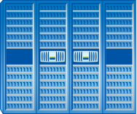



Arquitetura unificada da NetApp
Protocolos
Amplo portfólio de sistemas
Desempenho
FC
Flash Cache
FCoE
iSCSI
SSD
NFS
CIFS
FlexCache®
Objeto
FAS e Série V da NetApp® executando o
Data ONTAP®
Gerenciamento unificado
ferramentas e processos idênticos: aprenda uma vez, execute em qualquer lugar;
gerenciamento integrado de dados;
proteção integrada de dados;
unificação entre fornecedores.
Uma única arquitetura para diversas cargas de trabalho
Notes:
Objetivo do slide: explicar como a NetApp possui a arquitetura unificada mais robusta. Os próximos slides explicarão como o Data ONTAP 8.1 Modo de Cluster pode torná-la ainda melhor.
Pontos principais:
Os benefícios reais do storage unificado estão no nível da arquitetura, e não no nível individual.
Uma arquitetura unificada significa que não é preciso adotar uma abordagem do tipo "remover e substituir" quando você necessita de mais E/S ou, mais provavelmente, de diversos perfis de E/S e custos para diferentes requisitos de aplicativos e storage.
Com menos arquiteturas, você poderá ser mais eficiente e flexível.
Você pode aumentar a utilização do storage adotando uma única arquitetura em vez de uma abordagem com vários arrays que exige divisão em partes menores.
A capacidade de manipular várias cargas de trabalho e implantar diversas opções de tecnologia em uma única arquitetura proporciona flexibilidade para lidar com mudanças, pois quaisquer que sejam os requisitos de storage atuais, eles mudarão novamente nos próximos 12 a 18 meses.
Transição:
Vejamos quais os benefícios e a proposta de valor do Data ONTAP 8.1.

Slide 17




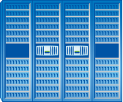

Storage Unificado
Única plataforma realmente unificada
SAN
NAS
Enterprise Departmental
Enterprise Departmental
iSCSI
Ethernet
LAN
FCoE
Fibre
Channel
SAN
(Block)
NAS
(File)
Integrado  Simples  Flexível
Notes:
NetApp produces a single product that spans file and block service, NAS and SAN – midrange and enterprise – with a single, consistent software suite. With the same modest investment in system admin training, you can manage 1176TB as easily as you can manage 1TB.
Note: FCoE connection requires Enhanced 10Gb Ethernet Switch with Data Center Bridging (DCB). All other Ethernet traffic, including iSCSI, can run at virtually any speed.

Slide 18

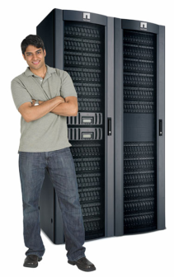

Benefícios do Storage Unificado
Indústria
NetApp®
High-End SAN
FAS family
Data ONTAP®
Low/Midrange SAN
NAS
Flexibilidade
Eficiência
Agilidade
Valor
Backup
Virtualization
Disaster Recovery
Archive & Compliance
Hardware diferente
Software diferente
Pessoas diferentes
Processos diferentes
Mesmo hardware
Mesmo software
Mesmas pessoas
Mesmos processos
Notes:
Points to make
The traditional industry approach forces you to buy different systems for different needs. This results in a high level of complexity, and often results in poor utilization with stranded silos of capacity and performance that cannot be shared or reallocated
You may be spending more than you need to on like-to-like environments for test and dev, archival, DR, D2D backup. With NetApp you can get like-to-unlike environments (protocols and mixed FC and SATA disks)
The industry approach means a lot of different processes, different staff, different hardware and software to learn and stay current on.
With NetApp’s unified approach, you can simplify your environment; a single hardware & software platform with common management, upgrades, training, people, diagnostics, provisioning
The reduction in complexity you get from NetApp can also reduce human error, the leading causes of downtime
Suggested script:
The unified approach means that you can use the same hardware, software, people, and processes for all your storage and data management requirements, regardless of tier, protocol or task. The advantages include higher people productivity, fewer errors, faster response and lower costs.
A good analogy is Southwest Airlines, who have chosen to standardize on the 737, an approach that has helped them become one of the most profitable airlines in the States. Their pilots, mechanics, air flight attendants and other personnel learn one airplane, one set of processes, and they can work on any plane in the fleet.
When Southwest Airlines was looking for a storage and data management partner, they selected NetApp because of the similarities in our approach. Southwest has broadly standardized on our solutions throughout their operations. If we aren’t running, Southwest can’t fly.
Transition:
We have the broadest portfolio of modular systems available from any vendor.

Slide 19
Eficiência no armazenamento

Slide 20
Efficiency is Built-in
Save
over
80%
Snapshot™ Copies
Point-in-time copies that write only changed blocks. No performance penalty.
Save
up to
46%
RAID 6 Protection
(RAID-DP®)
Protects against double disk failure with no performance penalty.
Virtual Copies (FlexClone®)
Near-zero space, instant “virtual” copies. Only subsequent changes in cloned dataset get stored.
Save
over
80%
Save
up to
33%
Thin Provisioning
(FlexVol®)
Create flexible volumes that appear to be a certain size but are really a much smaller pool.
Deduplication
Removes data redundancies in primary and secondary storage.
Save
up to
95%
Thin Replication
(SnapVault® and SnapMirror®)
Make data copies for disaster recovery and backup using a minimal amount of space.
Save
up to
95%
Data Compression
Removes redundant data patterns in primary and secondary storage.
Save
up to
87%

Slide 21
Efficiency is Built-in
Save
over
80%
Snapshot™ Copies
Point-in-time copies that write only changed blocks. No performance penalty.
Save
up to
46%
RAID 6 Protection
(RAID-DP®)
Protects against double disk failure with no performance penalty.
Virtual Copies (FlexClone®)
Near-zero space, instant “virtual” copies. Only subsequent changes in cloned dataset get stored.
Save
over
80%
Save
up to
33%
Thin Provisioning
(FlexVol®)
Create flexible volumes that appear to be a certain size but are really a much smaller pool.
Deduplication
Removes data redundancies in primary and secondary storage.
Save
up to
95%
Thin Replication
(SnapVault® and SnapMirror®)
Make data copies for disaster recovery and backup using a minimal amount of space.
Save
up to
95%
Data Compression
Removes redundant data patterns in primary and secondary storage.
Save
up to
87%

Slide 22
Compactação de dados da NetApp
Em linha
Pós-processo
Após a compactação de dados da NetApp
Deduplicação da NetApp em dados compactados
Dados brutos
Principais benefícios do recurso:
Valor para os negócios:
maior eficiência para mais cargas de trabalho;
melhor desempenho de gravação.
ajuda a aproveitar ainda mais o seu investimento;
mais aplicativos podem ser colocados on-line com mais rapidez.
Notes:
Com a compactação e a deduplicação ativadas no FlexVol, você obtém economia imediata de espaço com a compactação e economia cumulativa com a deduplicação posterior ao processo. A economia total não será necessariamente a soma das economias individuais. Para obter mais detalhes, consulte TR - 3505i.a - “Quando selecionar as boas práticas de deduplicação e/ou compactação”.
A compactação pode reduzir o uso do espaço físico na gravação inicial de dados em disco e a deduplicação removerá os blocos WAFL duplicados.

Slide 23
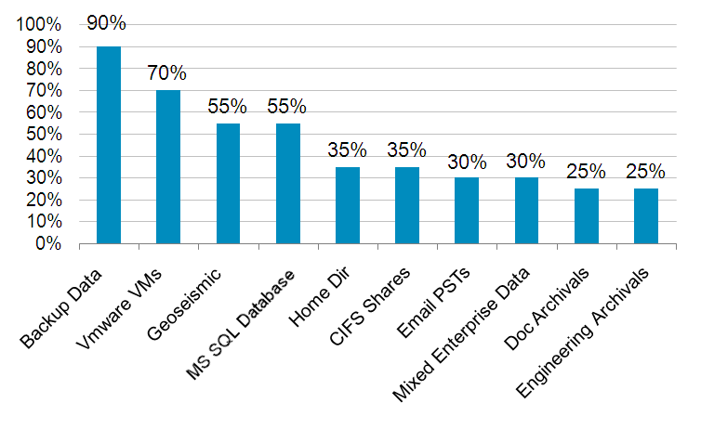
Economia de Espaço com Deduplicação NetApp
Exemplos – Economia de espaço varia conforme tipo de dado
Use NetApp Space Savings Estimation Tool (SSET) para validação
Economia Típica com Deduplicação NetApp
Percentual economizado

Slide 24



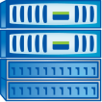
Essencial para Virtualização
Muitas máquinas virtuais tem a imagem 100% iguais
Traditional Enterprise RAID Arrays
NetApp FAS System
Duplicate Data
Is Eliminated
Economia com a remoção dos dados duplicados
  Incluindo backup, DR, clones de teste e cópias de archive.
Notes:
24
24
Goal of this slide: Show how NetApp Dedupe can vastly reduce virtualization storage requirements
VM’s store redundant data such as the Operations System, Patches, and software applications common to every virtual server.
Build
NetApp is able to reduce this down to a single instance with NetApp dedupe. This can provide space savings as much as 90% significantly reducing storage costs.
This capability is unique to NetApp and a strong selling point against the competition. Only NetApp can deduplicate primary data.
Savings across all tiers
Primary, backup, and archival data
50% space savings, or more
95% or greater for backup

Slide 25
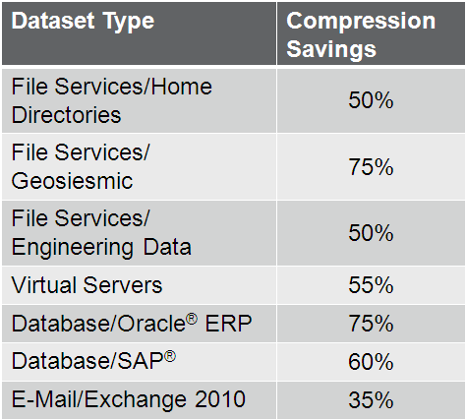
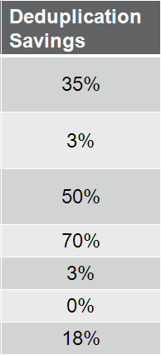
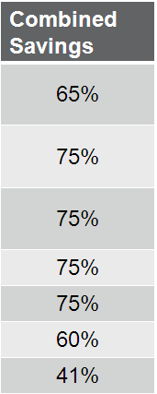
Sample Compression Savings
Results will vary greatly. NetApp recommends running SSET against your data to better predict your savings.
Notes:
These are sample savings we have achieved with internal and/or customer testing. Actual customer savings are highly dependent on the data type and data layout. It is highly recommended that you test your actual data with both the SSET tool, and in a test/dev environment.
For ONTAP 8.0.1 release, we are only recommending running File Services/IT Infrastructure on the primary storage infrastructure. These other data types might be good targets for backup/archive tiers.
SAP Database 8k block size – it was ~ 2TB and included 360 GB Database Freespace and 20 GB Temporary Tablespace
Oracle Database 8k block size - ~ 2TB

Slide 26

Comparing Dedupe and Compression
Logical Data
abcd
eabc
deaa
abcd
eaaa
bcde
abcd
eabc
Dedupe
abcd
eabc
deaa
abcd
Free
eaaa
bcde
Free
abcd
Free
eabc
Compression
abcd
eabc
de#!
*abc
deab
c
abcd
eabc
deaa
~>#!
*abc
abcd
eaaa
bcde
abcd
eabc
~>#!
*abc

Slide 27
Efficiency is Built-in
Save
over
80%
Snapshot™ Copies
Point-in-time copies that write only changed blocks. No performance penalty.
Save
up to
46%
RAID 6 Protection
(RAID-DP®)
Protects against double disk failure with no performance penalty.
Virtual Copies (FlexClone®)
Near-zero space, instant “virtual” copies. Only subsequent changes in cloned dataset get stored.
Save
over
80%
Save
up to
33%
Thin Provisioning
(FlexVol®)
Create flexible volumes that appear to be a certain size but are really a much smaller pool.
Deduplication
Removes data redundancies in primary and secondary storage.
Save
up to
95%
Thin Replication
(SnapVault® and SnapMirror®)
Make data copies for disaster recovery and backup using a minimal amount of space.
Save
up to
95%
Data Compression
Removes redundant data patterns in primary and secondary storage.
Save
up to
87%

Slide 28
SnapShotTM

Slide 29
NetApp Snapshot Technology
Instant zero-space copy
Snapshot technology is a core feature of the storage system’s WAFL file system
NetApp® WAFL® writes all data to available free space without writing over the previous data
Creating a Snapshot™ copy involves merely retaining pointers to the original data blocks
Performance impact is near zero because no additional disk operations are required beyond normal write behavior
Space is efficient because only new data written takes up incremental space on disk
Each volume can contain up to 255 Snapshot copies
Notes:
Because of the intelligent “write anywhere” design of WAFL, the mechanism for high-performance Snapshot copies is already in place. When new data is written to disk, NetApp Snapshot merely retains pointers to the modified data. NetApp Snapshot requires no movement of data and results in near-zero performance impacts. NetApp Snapshot is also space efficient and requires only the incremental capacity to store modified data.

Slide 30
NetApp Snapshot Technology
Blocks in
LUN or File
Blocks
on the Disk
Cria Snapshot 1:
  Sem movimentação de dados
  Somente copia de ponteiros
A
A
A
B
B
B
C
C
C
Snap 1
Notes:
NETAPP SNAPSHOT TECHNOLOGY
This presentation was originally done by Dave Hitz, one of the founders of the company, who is now an executive vice president. He did this presentation for the 2005 Fall Classic. It is a very good description of our Snapshot technology, as well as how our competitors’ snapshot technologies work.
How does NetApp Snapshot technology work?
Data ONTAP starts in the same way as random access mediums with pointers to physical locations, the same as USB drives, or thumb drives, as well as any other types of disks, such as floppy disks. When Data ONTAP creates a Snapshot copy, it preserves the inode map as it is at that point in time and then continues to make changes to the inode map on the active file system. Data ONTAP keeps the old version of the inode map. There is no data movement at the time that the Snapshot copy is created.

Slide 31
NetApp Snapshot Technology (Cont.)
Blocks in
LUN or File
Blocks
on the Disk
Cria Snapshot 1
Continua escrevendo dados
A
A
A
B1
B1
B
B
Cria Snapshot 2
  Sem movimentação de dados
  Somente copia ponteiros
C
C
C
B1
A
B
C
Snap 1
Snap 2
Notes:
NETAPP SNAPSHOT TECHNOLOGY
As Data ONTAP writes changes to disk, the changed version of block B gets written to a new location, B1 in this example. That enables the file system to avoid all of the parity update changes that would be required if the new data were written to the original location. If Data ONTAP updated the same block, it would have to do a number of parity reads to be able to update both parity drives. The Data ONTAP WAFL file system writes the changed block to a new location, again writing complete stripes and not moving or changing the original data blocks.
When the file system creates the next Snapshot copy, the new Snapshot copy just points to the unchanged blocks A and C and to block B1, the new location for the changed contents of block B. That is it. Data ONTAP does not move any data, it just keeps building on the original active file system. It is extremely simple and efficient. There is not a lot of complexity here, and because it is so simple, it is very good for disk utilization. The only extra blocks used as changes are made are those needed for the new or updated blocks.

Slide 32
NetApp Snapshot Technology (cont.)
Blocks in
LUN or File
Blocks
on the Disk
Cria Snapshot 1
Continua escrevendo dados
Cria Snapshot 2
A
A
A
B1
B1
B
B1
C2
C2
C
C
Continua escrevendo dados
B1
C2
Cria Snapshot 3
A
A
Modelo Simples
  Melhor utilização dos discos
  Sem degradação de performance
B
B1
C
C
Snap 1
Snap 2
Snap 3
Notes:
NETAPP SNAPSHOT TECHNOLOGY
Snapshot copies have very good performance characteristics. There are no extra I/O operations happening here. Functionally, the system can realistically provide an unlimited number of Snapshot copies. There is a hard limit of 255 Snapshot copies per volume online, and in most production environments that is more than would be used. A couple dozen active Snapshot copies at a time are really the most you will find in production environments, even though many more could be utilized if needed.
Secondary archival environments certainly use many more Snapshot copies. There is now a way, using FlexClone technology, to literally take an unlimited number of Snapshot copies of a volume. A user could take up to 254 Snapshot copies, and then, on that last Snapshot, create a FlexClone. Then the user can take another 254 and clone it again and take another 254, and so on. So today we really do have unlimited Snapshot copies.

Slide 33
Como os outros fazem Snapshot
(COW – Copy On Write)

Slide 34
Snapshots dos concorrentes
Cria snapshot 1:
  Cria copia fora, na região fora 1
Blocks in
LUN
Blocks
on the Disk
A
A
  Cria ponteiros para os blocos antigos e cópia fora 1
B
B
C
C
Copy
Out 1
A
B
C
Snap 1
Notes:
EMC (& others) use an older architectural paradigm: BASE + OFFSET. Volumes are defined by a BASE. And blocks are accessed from the volume at an OFFSET from the BASE. As a result, Snapshoted data has to physically move out of the offset location for a particular block of data. Let’s see what that means to system operation …

Slide 35
Snapshots dos concorrentes
Cria snapshot 1
Blocks in
LUN
Blocks
on the Disk
Continua escrevendo
  Altera um bloco
A
A
  Lê o bloco antigo; Escreve na área de fora 1
B
B1
B1
B
B
C
C
  Atualiza o ponteira para o bloco da área fora 1
Copy
Out 1
  Altera o bloco no disco
A
Uma escrita requer:
  1 leitura (dado antigo)
  1 escrita (dado antigo)
  1 escrita (dado novo)
Mínimo 3x overhead
A
B
B
C
C
Snap 1
Snap 1

Slide 36
Snapshot dos concorrentes
Cria snapshot 1
Blocks in
LUN
Blocks
on the Disk
Continua escrevendo dados
A
A
B
Cria snapshot 2:
  Cria cópia na região fora 2
B1
B1
C
C
B
Copy
Out 1
  Cria ponteiros para os blocos antigos e cópia fora 2
Copy
Out 2
A
A
A
B
B
B1
C
C
C

copy
out 1

copy
out 2
Snap 1
Snap 1
Snap 2

Slide 37
Snapshot dos concorrentes
Blocks in
LUN
Blocks
on the Disk
Cria snapshot 1
Continua escrevendo
A
A
Cria snapshot 2
B
B1
B1
Continua escrevendo
  Altera bloco
C
C2
C2
C
C
C
B
Copy
Out 1
  Bloco antigo é escrito para todos as regiões for a.
Copy
Out 2
A
  Atualiza todos os ponteiros
A
A
A
B
B
B
B1
C
  Atualiza bloco no disco
C
C
C

copy
out 1

copy
out 2
Uma escrita requer:
  1 leitura
  3 escritas
Snap 1
Snap 1
Snap 2

Slide 38
Comparação de Snapshot : NetApp vs Others
Com tecnologia NetApp:
Mínimo de overhead
  Garantia de eficiência de espaço em disco
Sem movimentação de dados
  Garantia de performance
  Permite mais snapshots
NetApp
Others
A
A
B
B1
C
Used
Disk
Space
C2
B1
B
C2
C
C
Espaço em disco é melhor utilizado
Performance é melhor
No. de snapshots é melhor
Comparação lado a lado com 2 snapshots

Slide 39
SnapRestore
Features and Functions
Restores lost or corrupted data from one of up to
255 disk-based recovery points (Snapshot™ copies)
Intra-system
  No data movement → subsecond speed
  No burden to the storage network
  No burden to the application server
Can be coarse- or fine-grained
  Single volume
  Single file or LUN
Benefits
Keeps business running 24 x 7
Minimizes infrastructural cost (in manpower, tape infrastructure)
Notes:
SFSR = single-file SnapRestore: Referred to as such, but usable to restore a single LUN as well.

Slide 40
Using Snapshot to Restore Data
Assume that block C2 is corrupted (for example, a virus attack)
Blocks in
LUN or File
Blocks
on the Disk
A
A
B
B1
B
C
C2
C2
C
B1
C2
C2
A
A
A
B
B1
B1
C
C
C2
C2
Snap 1
Snap 2
Snap 3

Slide 41
Using Snapshot to Restore Data (cont.)
Blocks
in File
Blocks
on the Disk
Block C2 is corrupted
Let users self-restore from .snapshot directory
A
A
B
B1
B
C
C2
C2
C
.snapshot
directory
B1
C2
C2
A
A
A
A
B
B1
B1
B1
C
C
C
C2
Snap 1
Snap 2
Snap 2
Snap 3

Slide 42
Using Snapshot to Restore Data (cont.)
Blocks in
LUN or File
Blocks
on the Disk
Block C2 is corrupted
Let users self-restore from .snapshot directory
A
A
B
B1
B
C
C2
C2
SnapRestore®
C
C
B1
Restore from Snapshot™
copy with SnapRestore
  Move pointers from good Snapshot copy to active file system
C2
A
A
A
A
A
B
B1
B1
B1
B1
C
C
C
C
C2
Snap 1
Snap 2
Snap 2
Snap 3

Slide 43
Efficiency is Built-in
Save
over
80%
Snapshot™ Copies
Point-in-time copies that write only changed blocks. No performance penalty.
Save
up to
46%
RAID 6 Protection
(RAID-DP®)
Protects against double disk failure with no performance penalty.
Virtual Copies (FlexClone®)
Near-zero space, instant “virtual” copies. Only subsequent changes in cloned dataset get stored.
Save
over
80%
Save
up to
33%
Thin Provisioning
(FlexVol®)
Create flexible volumes that appear to be a certain size but are really a much smaller pool.
Deduplication
Removes data redundancies in primary and secondary storage.
Save
up to
95%
Thin Replication
(SnapVault® and SnapMirror®)
Make data copies for disaster recovery and backup using a minimal amount of space.
Save
up to
95%
Data Compression
Removes redundant data patterns in primary and secondary storage.
Save
up to
87%

Slide 44
FlexClone ®

Slide 45



Requerimentos em Storage Tradicional
Produção
Cópia Remota
Produção 100GB
Cópia Remota 100GB
Desenvolvimento 300GB
Mirror
Teste 300GB
Total: 800GB
Cópias de
Desenvolvimento
8x espaço inicial
Demorado
Complexo
Overhead de recurso (espaço em disco e administração de storage)
Cópias de
Teste

Slide 46
Requerimentos de Storage com FlexClone
Produção
Cópia Remota
Produção 100GB
Cópia Remota 100GB
Desenvolvimento 30GB
SnapMirror®
Teste 30GB
Total: 260GB
Cópias de
Desenvolvimento
Mais de 67% de redução da necessidade de storage
Cópias “quase” instantâneas
Overhead mínimo
Habilidade de ter várias cópias de Dev e Teste
Cópias de
Teste
Premissa: Até 10% de modificação nos ambientes de Dev e Teste

Slide 47
Using FlexClone to Restore and Test
Blocks in
LUN or File
Blocks
on the Disk
Block C2 is corrupted;
you want to restore and reproduce the error
A
A
B
B1
B
C
C2
C2
C
B1
C2
C2
A
A
A
B
B1
B1
C
C
C2
Snap 1
Snap 2
Snap 3
Notes:
A corrupted data block may be due to a virus or some other external influence.

Slide 48
Using FlexClone to Restore and Test (cont.)
Blocks in
LUN or File
Blocks
on the Disk
Block C2 is corrupted;
you want to restore and reproduce the error
A
A
B
B1
B
Restore from snap 2
C
C
B1
A
A
A
B
B1
B1
C
C
C2
Snap 1
Snap 2
Snap 3

Slide 49
Using FlexClone to Restore and Test (cont.)
Cloned
Data
Blocks in
LUN or File
Blocks
on the Disk
Block C2 is corrupted;
you want to restore and reproduce the error
A
A
A
B1
B
B1
B
Restore from snap 2
C
C
C
Clone from snap 2
B1
A
A
A
B
B1
B1
C
C
C2
Snap 1
Snap 2
Snap 3

Slide 50
Using FlexClone to Restore and Test (cont.)
Cloned
Data
Blocks in
LUN or File
Blocks
on the Disk
Block C2 is corrupted;
you want to restore and reproduce the error
A
A
A
B1
B
B1
B
Restore from snap 2
C
C4
C
C3
C
Clone from snap 2
B1
C3
Results:
  Both file systems can
  make edits
  Both file systems
  share common blocks
  Enables large-scale
  parallel testing
C4
A
A
A
B
B1
B1
C
C
C2
Snap 1
Snap 2
Snap 3
Notes:
Oracle example: Oracle makes hundreds of copies of a database in the development organization to test various run-time scenarios. The space savings are awesome. The entire Oracle process now requires NetApp. EMC, for example, makes a unique copy for each clone, which would kill their process.

Slide 51
FlexClone: Common Use Cases
Test and development
  Testing using large production databases
  Remote site testing
SAN boot
  Reduce space required for duplicate OS images when booting off SAN
  Multiserver deployments where small variations in the OS image are required, such as grid computing
  Clones can be made at the file level
Data mining where R/W is required
Notes:
NetApp FlexClone is well suited for test and development environments. Individuals can run their own tests for dramatic improvement in application test, product simulation, and development. Being able to test faster and more often enables companies to improve time to market and to do so with better quality assurance and less cost. A FlexClone copy is cloneable, allowing changes in the FlexVol volume to branch in ways similar to the way SW engineers branch source code trees—a feature very applicable to complex design tasks and larger teams.
As an example, Oracle makes hundreds of copies of a database in its development organization using FlexClone to test various run-time scenarios. The space savings are dramatic. The entire Oracle process now requires NetApp. In contrast, EMC clones make a unique copy for each clone, which would kill Oracle’s development process.
FlexClone also works great in production applications, such as SAN boot. One of the advantages of using network storage is the ability to move storage off of the server and onto shared storage. This advantage also applies to boot volumes. Moving the boot volumes to the network storage improves boot performance, protects the boot image, simplifies software management, and increases disk utilization by eliminating storage islands. FlexClone adds one more advantage for environments with many servers booting off of a common OS image. Rather than requiring a duplicate physical copy for each boot LUN, FlexClone creates a zero space copy of the boot LUN. State changes are still captured, because a FlexClone copy is a writable copy. Each clone can be mounted like any other volume, only with less space required on disk. Cloning boot images is especially useful in grid computing environments or with virtual servers.
FlexClone is also useful for data mining environments with high amounts of read/write activity.
Individuals can run their own tests for dramatic improvement in application test, simulation, and development environments. By being able to test faster and more often, companies can improve time to market and do so with better quality assurance and less cost.
Testing: For database environments using SW such as SAP, PeopleSoft, Siebel, to work out bugs and issues before trying on real data.
Development example: Chip development, where 20 or 30 variations on a core design are needed (a variation for each different manufacturer or use).
Simulation: Crash testing a car (front, side, rear).
Legacy cloning data is difficult. When the implementation is space, time, and resource consuming, many companies are forced to choose between doing exhaustive quality testing and getting their product to market faster. A better implementation is needed.
Data ONTAP 7G enables users to make and work with many copies quickly while using minimal physical space. This allows multiple people to run their own tests without affecting the core data. The benefit is more tests running faster and less expensively for improved quality.
Many copies instantly: Legacy cloning might take hours or even days to make a single copy of a data set. FlexClone allows DBAs to create one clone or many in minutes without disrupting the system.
Because they take only minutes to make, they can save you 5 to 10 times the cost of your current storage.
DBAs use features like DB2 write-suspend and Oracle hot-backup mode to transparently prepare the production volume for cloning by delaying write activity to the database. This is necessary because databases need to control their own points of consistency.
Space efficient: A legacy clone requires 100% additional space. Flexible clones don’t use space until you begin making changes (writing new data, changing old data).
Clones are cloneable: This allows changes in the FlexVol volume to branch in ways similar to the way SW engineers branch source code trees—a capability you really appreciate with complex design tasks and larger teams.
Key sources:
Introduction to Data ONTAP Release 7G
http://www.netapp.com/tech_library/ftp/3356.pdf
A Thorough Introduction to FlexClone Volumes
http://www.netapp.com/tech_library/ftp/3347.pdf

Slide 52
Efficiency is Built-in
Save
over
80%
Snapshot™ Copies
Point-in-time copies that write only changed blocks. No performance penalty.
Save
up to
46%
RAID 6 Protection
(RAID-DP®)
Protects against double disk failure with no performance penalty.
Virtual Copies (FlexClone®)
Near-zero space, instant “virtual” copies. Only subsequent changes in cloned dataset get stored.
Save
over
80%
Save
up to
33%
Thin Provisioning
(FlexVol®)
Create flexible volumes that appear to be a certain size but are really a much smaller pool.
Deduplication
Removes data redundancies in primary and secondary storage.
Save
up to
95%
Thin Replication
(SnapVault® and SnapMirror®)
Make data copies for disaster recovery and backup using a minimal amount of space.
Save
up to
95%
Data Compression
Removes redundant data patterns in primary and secondary storage.
Save
up to
87%

Slide 53
SnapMirror®

Slide 54



SnapMirror®
SnapMirror é uma solução de replicação simples, flexível e econômica que permite a proteção dos dados das aplicações
Benefícios
Primary Data Center
DR Site
Solução econômica
  Mirror entre FC e SATA
  Baseado em Snapshots – economiza espaço e banda
A cópia DR é usada para ativar aplicação
  Acesso de leitura e escrita
SnapMirror
FAS
FAS or NearStore®
A Solução de Replicação Líder de Mercado, de acordo com o IDC

Slide 55



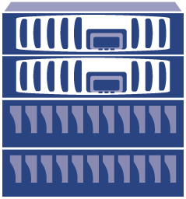


SnapMirror®
Synchronous SnapMirror
1
Every Write
2
Não exposto a perda de dados
Distância replicação < 100 km
Algum impacto de performance
4
3
Semi-Synchronous SnapMirror
Exposto a perder segundos de dados
Estende além de 100 km
Sem impacto de performance
1
Every Write
3
2
4
Asynchronous SnapMirror
Exposto a perder de minutos a horas de dados
Sem limite de distância
Sem impacto de performance
1
3
A
Changed blocks
B
2
12
Set intervals

Slide 56
SnapVault®

Slide 57

SnapVault®
SnapVault é uma solução de D2D backup entre storages NetApp
Benefícios
Primary Data Center
Secondary site
Solução econômica
  Backup de FC para SATA
  Baseado em Snapshots – economiza espaço e banda
A cópia é utilizável
  Acesso de leitura para backup ou distribuição de dados no site remoto
  Clones no site remoto para testes de aplicações, QA e homologação
SnapVault™
FAS
FAS

Slide 58


SnapVault®
SnapVault™
Backups mais rápidos
Eficiente no espaço e bandas usados
Acesso online das centenas de backups full
NetApp Primary Storage
NetApp Secondary Storage
Transferência do baseline
Transfere somente incremental
Store only incremental changes
Active
File System
1
Recria backup full
2
3
A
B
C
D
C’
A
B
C
D
C’
Bloco de dados
SnapVault™
Snapshot
SnapVault
Backup 1
SnapVault
Backup 2
SnapVault
Backup 3

Slide 59
Efficiency is Built-in
Save
over
80%
Snapshot™ Copies
Point-in-time copies that write only changed blocks. No performance penalty.
Save
up to
46%
RAID 6 Protection
(RAID-DP®)
Protects against double disk failure with no performance penalty.
Virtual Copies (FlexClone®)
Near-zero space, instant “virtual” copies. Only subsequent changes in cloned dataset get stored.
Save
over
80%
Save
up to
33%
Thin Provisioning
(FlexVol®)
Create flexible volumes that appear to be a certain size but are really a much smaller pool.
Deduplication
Removes data redundancies in primary and secondary storage.
Save
up to
95%
Thin Replication
(SnapVault® and SnapMirror®)
Make data copies for disaster recovery and backup using a minimal amount of space.
Save
up to
95%
Data Compression
Removes redundant data patterns in primary and secondary storage.
Save
up to
87%

Slide 60
Thin Provisioning

Slide 61


What Is Thin Provisioning?
Storage capacity as seen by the host and applications
App 1
App 2
App 3
App 1
App 2
App 3
Logical storage capacity presented to the host (FlexVol® volume or LUN)
Physical storage capacity on the NetApp® system (aggregate)
Notes:
Thin provisioning can be defined as the ability :
Provision more logical space than the available physical space.
Ability to allocate space for incoming data on-demand as the data comes in, instead of a pre-allocation.
This slide highlights the first aspect while the next slide highlights the other aspect
The underlying physical storage, depicted by the gray aggregate, is available to store data. However, the volumes (depicted in blue) within the aggregate are using thin provisioning and will not use up space within the aggregate until data is written to it. This allows the volumes to advertise more space to the hosts and applications than is physically available within the aggregate. The aggregate can be extended by adding more disks on the fly, as the volumes have more data written to them. This allows the physical storage to be purchased and installed as it is used.

Slide 62
What Is Thin Provisioning?
 | Initially provisioned | After data is written | Some data is deleted | More data gets written | More storage added
Logical space as viewed by the client
Physical space on the storage system |  |  |  | Grow physical space as used
Used
Used
Used
Used
Used
Used
Used
Used
Notes:
When using thin provisioning, the physical space is allocated to a volume as data is written to the storage system.
In this slide the gray areas represent physical storage that is installed in the physical system, and the blue represent the amount of space that has been allocated (because data was written to it). The top row represent the logical view that the client would see. The client would see that all expected storage is there waiting to be used, thus the size of the container remains constant across the entire row, and as a result there is plenty of unused space across the top row. The bottom row shows what is actually happening on the storage system. The physical space starts with a reduced amount of space, then as data is written to it and fills the space. It remains this smaller size as data is written and deleted. But then when more data gets written to it in the final two steps, more disks are added to grow the physical space to stay ahead of the demand on the physical space.
In summary, the client sees all the space that it expects to see, while thin provisioning is being used behind the scene to grow the physical storage as it is used.
NOTE:
In NAS configs, when data is deleted from the host, that space is freed up on the storage system is returned to the aggregate
In SAN configs reclaiming deleted space requires host integration. NetApp has integration with many of the major vendors to be able to free space on the storage system when files are deleted inside LUNs. More on that as we go through the presentation.

Slide 63
Thin Provisioning New Storage
Aggregate containing usable physical space (1TB)
Aggregate
Notes:
Flexibility of Thin Provisioning improves utilization and eases management
This example provides an overview explanation of thin provisioning for volumes within an aggregate.
The aggregate in this example is created so that 1TB of storage is available to store data
Multiple volumes are created within the aggregate and are configured to use thin provisioning. This means that none of the space from the physical disk will actually be used (or reserved) until data is written to a volume. In this example, 4TB worth of volumes are represented within the aggregate. The ability to oversubscribe the containers allows for many containers with low utilization to co-exist within the same aggregate, making use of un-used space.
As data is written to the volume, the space is allocated from the physical disks and is used to store data for the volume. In this example, a total of 800GB of data has been written across all the volumes. The data can be written in any amount to any volume, as long as space is available within the 1TB of physical space. This ability to share space across all volumes within the aggregate can be leveraged to quickly respond to storage needs within a dynamic environment. Monitoring and managing storage at the higher aggregate level reduces the level of work to manage the storage environment, as compared to managing at the volume level.
The amount of free space within the aggregate is monitored via thresholds, and can be expanded by adding more disks at any time.
The volumes in this example have been filled at this point so that 800GB of 1000GB are being used, providing 80% utilization. At 80% utilization, the aggregate would likely be grown by a predetermined increment in preparation for future data growth. Without thin provisioning, the aggregate would have needed 4TB of space to allow the thick provisioned volumes to allocate (pre-reserve) their physical space. This would result in using 800GB of 4000GB, providing 20% utilization. We have found that average utilization is ~30% without thin provisioning, as supported by AutoSupport stats.

Slide 64
Thin Provisioning New Storage continued
Aggregate containing usable physical space (1TB)
Physical Storage = 1TB
Aggregate
Notes:
Flexibility of Thin Provisioning improves utilization and eases management
This example provides an overview explanation of thin provisioning for volumes within an aggregate.
The aggregate in this example is created so that 1TB of storage is available to store data
Multiple volumes are created within the aggregate and are configured to use thin provisioning. This means that none of the space from the physical disk will actually be used (or reserved) until data is written to a volume. In this example, 4TB worth of volumes are represented within the aggregate. The ability to oversubscribe the containers allows for many containers with low utilization to co-exist within the same aggregate, making use of un-used space.
As data is written to the volume, the space is allocated from the physical disks and is used to store data for the volume. In this example, a total of 800GB of data has been written across all the volumes. The data can be written in any amount to any volume, as long as space is available within the 1TB of physical space. This ability to share space across all volumes within the aggregate can be leveraged to quickly respond to storage needs within a dynamic environment. Monitoring and managing storage at the higher aggregate level reduces the level of work to manage the storage environment, as compared to managing at the volume level.
The amount of free space within the aggregate is monitored via thresholds, and can be expanded by adding more disks at any time.
The volumes in this example have been filled at this point so that 800GB of 1000GB are being used, providing 80% utilization. At 80% utilization, the aggregate would likely be grown by a predetermined increment in preparation for future data growth. Without thin provisioning, the aggregate would have needed 4TB of space to allow the thick provisioned volumes to allocate (pre-reserve) their physical space. This would result in using 800GB of 4000GB, providing 20% utilization. We have found that average utilization is ~30% without thin provisioning, as supported by AutoSupport stats.

Slide 65
Thin Provisioning New Storage continued
Aggregate containing usable physical space (1TB)
Create volumes with no guarantees (4TB represented)
600 GB
400 GB
2TB
200 GB
300 GB
100 GB
400 GB
Physical Storage = 1TB
Aggregate
Notes:
Flexibility of Thin Provisioning improves utilization and eases management
This example provides an overview explanation of thin provisioning for volumes within an aggregate.
The aggregate in this example is created so that 1TB of storage is available to store data
Multiple volumes are created within the aggregate and are configured to use thin provisioning. This means that none of the space from the physical disk will actually be used (or reserved) until data is written to a volume. In this example, 4TB worth of volumes are represented within the aggregate. The ability to oversubscribe the containers allows for many containers with low utilization to co-exist within the same aggregate, making use of un-used space.
As data is written to the volume, the space is allocated from the physical disks and is used to store data for the volume. In this example, a total of 800GB of data has been written across all the volumes. The data can be written in any amount to any volume, as long as space is available within the 1TB of physical space. This ability to share space across all volumes within the aggregate can be leveraged to quickly respond to storage needs within a dynamic environment. Monitoring and managing storage at the higher aggregate level reduces the level of work to manage the storage environment, as compared to managing at the volume level.
The amount of free space within the aggregate is monitored via thresholds, and can be expanded by adding more disks at any time.
The volumes in this example have been filled at this point so that 800GB of 1000GB are being used, providing 80% utilization. At 80% utilization, the aggregate would likely be grown by a predetermined increment in preparation for future data growth. Without thin provisioning, the aggregate would have needed 4TB of space to allow the thick provisioned volumes to allocate (pre-reserve) their physical space. This would result in using 800GB of 4000GB, providing 20% utilization. We have found that average utilization is ~30% without thin provisioning, as supported by AutoSupport stats.

Slide 66
Thin Provisioning New Storage continued
Aggregate containing usable physical space (1TB)
Create volumes with no guarantees (4TB represented)
Oversubscribed physical storage
  1TB, but host sees 4TB
600 GB
400 GB
2TB
200 GB
300 GB
100 GB
400 GB
No space on disks is used yet
Physical Storage = 1TB
Aggregate
Notes:
Flexibility of Thin Provisioning improves utilization and eases management
This example provides an overview explanation of thin provisioning for volumes within an aggregate.
The aggregate in this example is created so that 1TB of storage is available to store data
Multiple volumes are created within the aggregate and are configured to use thin provisioning. This means that none of the space from the physical disk will actually be used (or reserved) until data is written to a volume. In this example, 4TB worth of volumes are represented within the aggregate. The ability to oversubscribe the containers allows for many containers with low utilization to co-exist within the same aggregate, making use of un-used space.
As data is written to the volume, the space is allocated from the physical disks and is used to store data for the volume. In this example, a total of 800GB of data has been written across all the volumes. The data can be written in any amount to any volume, as long as space is available within the 1TB of physical space. This ability to share space across all volumes within the aggregate can be leveraged to quickly respond to storage needs within a dynamic environment. Monitoring and managing storage at the higher aggregate level reduces the level of work to manage the storage environment, as compared to managing at the volume level.
The amount of free space within the aggregate is monitored via thresholds, and can be expanded by adding more disks at any time.
The volumes in this example have been filled at this point so that 800GB of 1000GB are being used, providing 80% utilization. At 80% utilization, the aggregate would likely be grown by a predetermined increment in preparation for future data growth. Without thin provisioning, the aggregate would have needed 4TB of space to allow the thick provisioned volumes to allocate (pre-reserve) their physical space. This would result in using 800GB of 4000GB, providing 20% utilization. We have found that average utilization is ~30% without thin provisioning, as supported by AutoSupport stats.

Slide 67
Thin Provisioning New Storage continued
Aggregate containing usable physical space (1TB)
Create volumes with no guarantees (4TB represented)
Oversubscribed physical storage
  1TB, but host sees 4TB
Allocate space as data written (600GB so far)
600 GB
400 GB
2TB
200 GB
300 GB
100 GB
400 GB
Physical Storage = 1TB
Aggregate
Notes:
Flexibility of Thin Provisioning improves utilization and eases management
This example provides an overview explanation of thin provisioning for volumes within an aggregate.
The aggregate in this example is created so that 1TB of storage is available to store data
Multiple volumes are created within the aggregate and are configured to use thin provisioning. This means that none of the space from the physical disk will actually be used (or reserved) until data is written to a volume. In this example, 4TB worth of volumes are represented within the aggregate. The ability to oversubscribe the containers allows for many containers with low utilization to co-exist within the same aggregate, making use of un-used space.
As data is written to the volume, the space is allocated from the physical disks and is used to store data for the volume. In this example, a total of 800GB of data has been written across all the volumes. The data can be written in any amount to any volume, as long as space is available within the 1TB of physical space. This ability to share space across all volumes within the aggregate can be leveraged to quickly respond to storage needs within a dynamic environment. Monitoring and managing storage at the higher aggregate level reduces the level of work to manage the storage environment, as compared to managing at the volume level.
The amount of free space within the aggregate is monitored via thresholds, and can be expanded by adding more disks at any time.
The volumes in this example have been filled at this point so that 800GB of 1000GB are being used, providing 80% utilization. At 80% utilization, the aggregate would likely be grown by a predetermined increment in preparation for future data growth. Without thin provisioning, the aggregate would have needed 4TB of space to allow the thick provisioned volumes to allocate (pre-reserve) their physical space. This would result in using 800GB of 4000GB, providing 20% utilization. We have found that average utilization is ~30% without thin provisioning, as supported by AutoSupport stats.

Slide 68
Thin Provisioning New Storage continued
Aggregate containing usable physical space (1TB)
Create volumes with no guarantees (4TB represented)
Oversubscribed physical storage
  1TB, but host sees 4TB
Allocate space as data written (600GB so far)
Can grow aggregate on demand by adding disks (now 1.8TB)
600 GB
400 GB
2TB
200 GB
300 GB
100 GB
400 GB
Physical Storage = 1.8TB
Aggregate
Notes:
Flexibility of Thin Provisioning improves utilization and eases management
This example provides an overview explanation of thin provisioning for volumes within an aggregate.
The aggregate in this example is created so that 1TB of storage is available to store data
Multiple volumes are created within the aggregate and are configured to use thin provisioning. This means that none of the space from the physical disk will actually be used (or reserved) until data is written to a volume. In this example, 4TB worth of volumes are represented within the aggregate. The ability to oversubscribe the containers allows for many containers with low utilization to co-exist within the same aggregate, making use of un-used space.
As data is written to the volume, the space is allocated from the physical disks and is used to store data for the volume. In this example, a total of 800GB of data has been written across all the volumes. The data can be written in any amount to any volume, as long as space is available within the 1TB of physical space. This ability to share space across all volumes within the aggregate can be leveraged to quickly respond to storage needs within a dynamic environment. Monitoring and managing storage at the higher aggregate level reduces the level of work to manage the storage environment, as compared to managing at the volume level.
The amount of free space within the aggregate is monitored via thresholds, and can be expanded by adding more disks at any time.
The volumes in this example have been filled at this point so that 800GB of 1000GB are being used, providing 80% utilization. At 80% utilization, the aggregate would likely be grown by a predetermined increment in preparation for future data growth. Without thin provisioning, the aggregate would have needed 4TB of space to allow the thick provisioned volumes to allocate (pre-reserve) their physical space. This would result in using 800GB of 4000GB, providing 20% utilization. We have found that average utilization is ~30% without thin provisioning, as supported by AutoSupport stats.

Slide 69
Mitigation Step for Migration Candidate
What if a volume requires more space
600 GB
400 GB
2TB
200 GB
300 GB
100 GB
400 GB
Physical Storage = 1.8TB
Aggregate

Slide 70
Mitigation Step for Migration Candidate continued
What if a volume requires more space
Autogrow volume
600 GB
400 GB
2TB
200 GB
300 GB
100 GB
400 GB
Physical Storage = 1.8TB
Aggregate

Slide 71
Mitigation Step for Migration Candidate continued
What if a volume requires more space
Autogrow volume
Vol migration; vol move for non-disruptive migration, vMotion
600 GB
400 GB
2TB
200 GB
300 GB
100 GB
400 GB
Physical Storage = 1.8TB
Aggregate
New Aggregate
Notes:
VOL MOVE
8.1 7-mode= LUN only
8.1 Cluster-Mode = LUN or VOL across cluster
WRAP-UP POINTS:
Configure new vs. existing – turn it on at any time
Turning it off –if sufficient storage is available, can turn off thin prov at any time
This applies to LUNs also (

Slide 72
Efficiency is Built-in
Save
over
80%
Snapshot™ Copies
Point-in-time copies that write only changed blocks. No performance penalty.
Save
up to
46%
RAID 6 Protection
(RAID-DP®)
Protects against double disk failure with no performance penalty.
Virtual Copies (FlexClone®)
Near-zero space, instant “virtual” copies. Only subsequent changes in cloned dataset get stored.
Save
over
80%
Save
up to
33%
Thin Provisioning
(FlexVol®)
Create flexible volumes that appear to be a certain size but are really a much smaller pool.
Deduplication
Removes data redundancies in primary and secondary storage.
Save
up to
95%
Thin Replication
(SnapVault® and SnapMirror®)
Make data copies for disaster recovery and backup using a minimal amount of space.
Save
up to
95%
Data Compression
Removes redundant data patterns in primary and secondary storage.
Save
up to
87%

Slide 73
RAID-DP

Slide 74
Por que usar RAID-DP NetApp?
RAID-DP faz o que o RAID5 e RAID1/0 não fazem:
  Provê proteção contra falha de 2 discos
  Provê grande melhoria na proteção dos dados sem custos adicionais para os clientes NetApp
  Otimizado para performance enquanto provê a máxima proteção
  Reduz o tempo de reconstrução do RAID group enquanto reduz o RISCO de exposição de uma segunda falha de disco no mesmo RAID group ou um erro não recuperável de media.
RAID-DP excede o nível de proteção do RAID10 sem a necessidade de duplicar o número de discos e aumentar os custos.

Slide 75
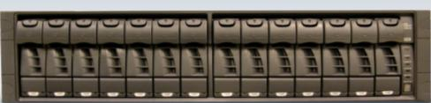
Highly Efficient RAID Protection
Greatly reduced parity overhead vs. typical RAID mirror
Superior fault tolerance
Recover from simultaneous failure of 2 drives
RAID 6 protection with no performance penalty
Typical RAID Protection
50% Efficiency
D
A
T
A
D
A
T
A
D
A
T
A
D
A
T
A
D
A
T
A
D
A
T
A
D
A
T
A
P
A
R
I
T
Y
P
A
R
I
T
Y
P
A
R
I
T
Y
P
A
R
I
T
Y
P
A
R
I
T
Y
P
A
R
I
T
Y
P
A
R
I
T
Y
RAID-DP® Protection
86% Efficiency
D
A
T
A
D
A
T
A
D
A
T
A
D
A
T
A
D
A
T
A
D
A
T
A
D
A
T
A
D
A
T
A
D
A
T
A
D
A
T
A
D
A
T
A
D
A
T
A
P
A
R
I
T
Y
P
A
R
I
T
Y
Notes:
Points to make:
RAID-DP gives you the same level of protection as full mirrors using far less disk space.
Protects against two simultaneous disk failures.
No performance penalties (see SPC-1 benchmark results)
Unlike generic RAID4 or RAID5 implementations which are architected without thought to file system structure and activity, the NetApp RAID implementation is heavily optimized to work in tandem with the file system.
By optimizing the file system and the RAID layer together, the NetApp RAID design provides all the benefits of parity RAID protection, without incurring the performance disadvantages associated with general-purpose RAID5 solutions.
Our RAID design does not interleave parity information, so the overall system can still be expanded quickly and easily, even though RAID protection is present.
Suggested script:
Here’s a graphical representation of NetApp RAID-DP advantage. We provides dual- parity RAID (RAID 6) called RAID-DP™, standard with Data ONTAP®. RAID-DP, when compared to RAID 10 data mirroring, offers far greater greater storage utilization. In addition, RAID-DP provides superior fault tolerance by recovering from the simultaneous failure of two drives, unlike other RAID levels that can only tolerate a single drive failure.
Transition:

Slide 76
NetApp Disk Failure Protection Solution Portfolio
RAID DP + 1
Increasing
Cost of
Protection
RAID 4 + 1
RAID DP
RAID 4
Checksums
1 Disk
Any 2 Disks
Any 3 disks
Any 5 Disks
Classes of Failure Scenarios

Slide 77
NetApp Disk Failure Protection Solution Portfolio
RAID DP + 1
Increasing
Cost of
Protection
RAID 4 + 1
RAID DP
RAID 4
Checksums
1 Disk
Any 2 Disks
Any 3 disks
Any 5 Disks
Classes of Failure Scenarios

Slide 78
NetApp Disk Failure Protection Solution Portfolio
RAID DP + 1
Increasing
Cost of
Protection
RAID 4 + 1
RAID DP
RAID 4
Checksums
1 Disk
Any 2 Disks
Any 3 disks
Any 5 Disks
Classes of Failure Scenarios

Slide 79
Aumentando a performance

Slide 80
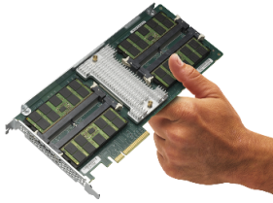
NetApp Flash Cache
Optimize Performance and Reduce Costs
Flash Cache improves average latency for random reads
Increase I/O throughput of disk-bound storage
systems without adding more disk drives
Reduce costs by using fewer, larger disk drives
Effective for file services, databases, messaging,
and virtual infrastructure
Predict your results before buying
for an existing storage system
Notes:
Slide Objective: Describe the functionality and benefits of Flash Cache (PAM II) modules.
Flash Cache modules are PCIe cards enterprise class (SLC) flash memory and a custom memory management unit. These cards fit into the expansion slots of a storage controller.
Our Flash Cache modules are intelligent read caches for user data and NetApp metadata. We say intelligent because what gets cached depends which of three modes of operation you select. [See the Technical FAQ for details about operation modes.]
Active data automatically flows into cache and ALL storage behind the controller is subject to caching. Do, you don’t have to guess what will get used a lot.
The traditional way to increase I/O throughput when the disk subsystem (not the CPU) is the bottleneck is to add more spindles. If you don’t need more capacity then this is a waste of storage. Caching can increase I/O throughput in a storage system without adding disks.
This approach is effective for workloads that are random in character and read intensive. Examples include file services, OLTP databases, messaging, and virtual infrastructure.
One of the nice things about our Flash Cache modules is that you can predict the results before adding cache to an existing storage system. A Data ONTAP (7.3+) feature called Predictive Cache Statistics simulates having a cache under your workload. It can predict whether adding cache would be helpful and how much to use.

Slide 81
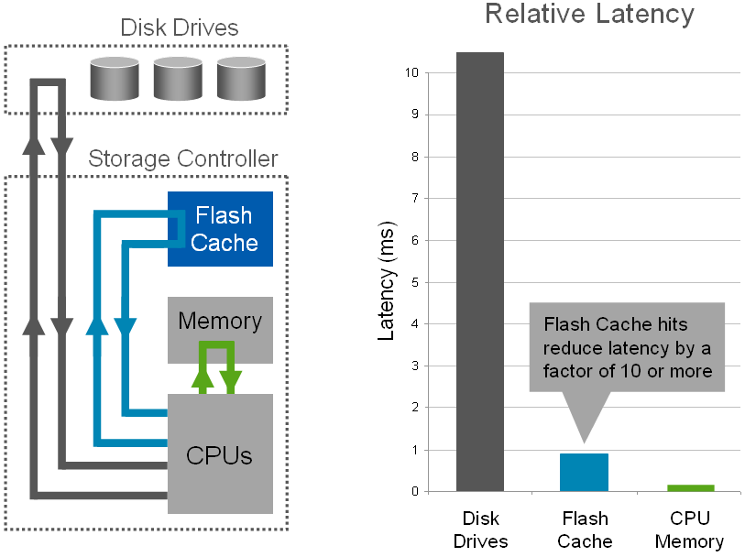
Reduce Latency with Flash Cache
Notes:
Here on the left we have a conceptual representation of a storage controller and an external disk drive shelf. In a conventional storage system, the processors can access data in two places: from disk or memory, as represented by the dark gray and green lines, respectively. If the data is not in memory then it will take over 100 times longer to get it from disk. A Flash Cache module is a read cache located on the PCI Express IO bus. A hit to the Flash Cache reduces latency, the time it takes to get data, by a factor of 10 compared to disk.
Flash Cache modules can also increase throughput for disk bound storage systems.

Slide 82



NetApp Cache Amplification
ESX Cluster
Datastore
VM
VM
VM
VM
NetApp FAS Array
Built into Data ONTAP
Set it and forget it
Works with ANY dataset
Without data migration
FlashCache
VM
Dedupe aware Cache
Disk Storage
VM
VM
VM
VM
Notes:
Dedupe aware cache – this is absolutely critical.

Slide 83
NetApp Cache Amplification
Datastore
with 80 VM’s
all IO satisfied
from cache
VM
VM
VM
VM
VM
VM
VM
VM
VM
VM
VM
VM
VM
VM
VM
VM
VM
VM
VM
VM
VM
VM
VM
VM
VM
VM
VM
VM
VM
VM
VM
VM
VM
VM
VM
VM
VM
VM
VM
VM
VM
VM
VM
VM
VM
VM
VM
VM
VM
VM
VM
VM
VM
VM
VM
VM
VM
VM
VM
VM
VM
VM
VM
VM
VM
VM
VM
VM
VM
VM
VM
VM
VM
VM
VM
VM
VM
VM
VM
VM
VM
VM
VM
VM
VM
VM
VM
VM
VM
VM
VM
VM
VM
VM
VM
VM
VM
VM
VM
VM
NetApp FAS
8,000%
VM
Cache Amplification
FlexCache
4 VM’s @ 50GB each
Dedupe to 50 GB
Cloned 20 times for 80 VM’s
50 GB of cache, amplified to
4000 GB of data
FlexVol
FlexClone
FlexClone
FlexClone
FlexClone
VM
VM
VM
VM
VM
FlexClone
FlexClone
FlexClone
FlexClone
VM
VM
VM
VM
FlexClone
FlexClone
FlexClone
FlexClone
VM
VM
VM
VM
FlexClone
FlexClone
FlexClone
FlexClone
VM
VM
VM
VM
FlexClone
FlexClone
FlexClone
FlexClone
VM
VM
VM
VM

Slide 84
FlexShare
Flexible Quality of Service for Optimized Storage Performance

Slide 85
FlexShare Gives Priority Service
To Your Most Important Workloads
Saturated Controller under
Same Workloads
Without FlexShare™
Latency is similar when controller is fully loaded and FlexShare is not used
High Priority
Volumes
Medium Priority
Volumes
Low Priority
Volumes
0
10
20
30
40
50
60
70
80
Latency (msec)
With FlexShare
FlexShare significantly reduces latency for high priority volumes
Latency for other volumes reflects their priority setting
High Priority
Volumes
Medium Priority
Volumes
Low Priority
Volumes
0
10
20
30
40
50
60
70
80
Latency (msec)

Slide 86
Utilizando todas as funcionalidades no mundo real

Slide 87
Consolidação de
File Server

Slide 88



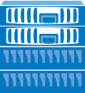

Consolidação de File Servers
Antes da NetApp
Com NetApp
Home
Directories
Shared
Storage
Software
Development
Home
Directories
Shared
Storage
Software
Development
AD, LDAP,
ou NIS
AD, LDAP,
ou NIS
Notes:
Key message: NetApp provides seamless integration with the existing environment while consolidating multiple existing file servers.
Talking points:
Seamless Integration – Allows customers to seamlessly integrate with the existing Authentication environment like Microsoft Active Directory, AD LDAP and Open LDAP, AD Kerberos and MIT Kerberos.
Consolidation – Allows customers to also consolidate their data serving different applications like Home Directories, Shared Storage, Custom Applications, Technical Applications, Software development.
Lower TCO – Many file servers consolidated into one NetApp System, thereby reducing the administrative overhead and also reducing the TCO.
NetApp started supporting Windows 2008 Active Directory and SMB2.0 protocol since Data ONTAP 7.2.4 and 7.3.1 onwards respectively.

Slide 89
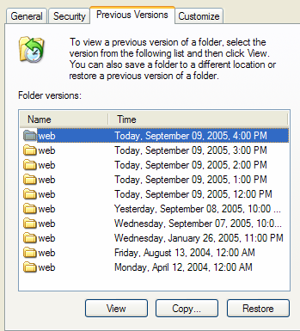
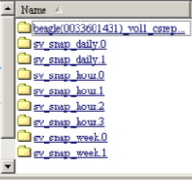
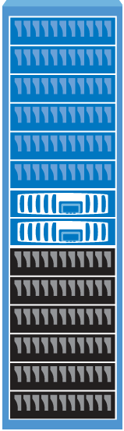






Restoring Files Rapidly
Primary Data Center
Remote Site
Remote Site
VSS
Secondary
Storage
Tape
User-Service Restore
SnapRestore®
LAN
Users can restore their own files in seconds
Administrators can recover volumes rapidly with SnapRestore
Administrators can recover local and remote systems quickly from disk-based backup archives
Notes:
Key message: NetApp dramatically simplifies the restore process with on-line access to recent backups, rapid restores and self-service recovery.
Talking Points:
Self Restore -Reduced administrative overhead - The ability for users to self-recover files eliminates IT intervention, reducing IT overhead.
Rapid data Recovery– NetApp can perform a full file system restore of an existing snapshot (point-in-time image) in a matter of seconds. Snapshots are kept on-line, minimizing the need to restore from tape and greatly accelerating the restore process, thus saving customers hours of time per restore request.
Rapid system recovery – In the event of a full system restore, online access to backups stored remotely on disk-based systems accelerates data restore and recovery.

Slide 90
Soluções de Storage
Application-aware

Slide 91






















Soluções de Storage NetApp
Consolidação de Infra-Estrutura
Mensagem & Colaboração
Soluções
NetApp
Operações
&
Gerenciamento
File Server
e
File Services
Banco de dados & Aplicações
Backup – Tradicional ou D2D

Slide 92
Microsoft Exchange

Slide 93

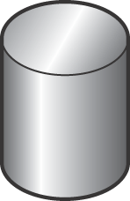
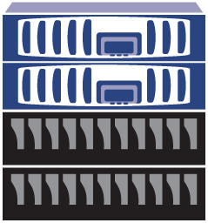

SnapManager for Exchange
Exchange Users
Immediate, nondisruptive
Any size DB
Back up during production hours
More frequent recovery points—up to minutes
Restore individual e-mails as needed ( SMBR )
Exchange Server
with SnapManager®
for Exchange
and SMBR
Backup
Restore
Primary
Data
9:00 AM
Snapshot
9:10 AM
Snapshot
Restore e-mails
9:20 AM
Snapshot
Outlook Client
with SMBR
SMBR = NetApp Single Mailbox Recovery
93
Notes:
Goal of Slide: This slide provides an overview of what a typical backup and recovery solution looks like for a local environment.
Benefits:
Note that NetApp SnapManager for Exchange and Single Mailbox Recovery software are running on one of the Exchange servers.
Snapshot copies can be made frequently (in this example, every 10 minutes) to protect more data without a significant impact on system performance → provides more frequent recovery points.
Individual e-mails can be restored from any Microsoft Outlook client with NetApp Single Mailbox Recovery software (SMBR).
93

Slide 94
Oracle
Notes:
94
Goal of Slide:
Transition
Key Messages:
Lets talk about the ways that NetApp is helping users today
Storage Efficiency

Slide 95



SnapManager for Oracle
DBA
DBA
DBA
Back up and restore in minutes
Comprehensive data protection using policy-based automation
Clone to primary or secondary storage
Perform Self-Service
Provision
DR
Backup/Recover
Test/Dev Copies
Policies and Management
Create new policies
Copy policies
Repurpose policies
Storage
Admin
Notes:
95
Points to make:
Here’s our approach
Storage experts set and document the data management policies needed for the applications
The applications administrators can request data management services like backup, restore, cloning, provision, from within their familiar application environment
All the application needs can be met quickly and conveniently, at the same time
Underlying infrastructure is hidden from the application administrator. They don’t have to be storage experts to get what they need themselves
Suggested script:
With our integrated data management approach, those routine services are available from within the application environment for self-service by the administrator. The storage team sets the policies, but otherwise are free from the old interrupt-driven manual routine of the old solution.
Transition:
This new data management approach opens the door to managing a pool of storage in a service model.

Slide 96
SAP

Slide 97



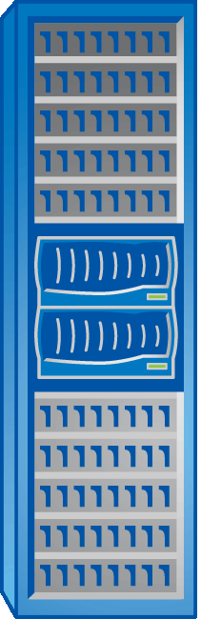





Usage of NetApp with SAP
SAN or NAS
SAN or NAS
Archival
Storage
Backup
Images
SnapVault®
NDMP
Primary
Storage
FlexClone®
Copies
Snapshot™
SnapRestore®
Secondary
Storage
Time to Backup: Minutes
Time to Restore: Minutes
All backup images are readable and writeable
Database verification; recovery from logical errors
97
Notes:
97

Slide 98



SnapManager® for SAP
SAP
Admin
Basis
Admin
Data management for SAP on Oracle
AIX, HP/UX, Solaris, Linux, Windows
Backup and recovery
  Fast, space-efficient backups
  Fast restore and recovery
Policy-driven data protection
  Automated backup replication from primary to secondary or DR storage
SAP system copies
  Automated, space-efficient system copies in minutes
  Active usage of backup images at secondary storage
  Active usage of DR image
SAP certified backup interface for BR*Tools
DBA
Perform Self-Service
Provision
DR
Backup/Recover
Dev/Test Copies
Policies and Management
Storage
Admin
Notes:
98
98

Slide 99
Virtualização
Server & Desktop

Slide 100






Virtual Storage Console Simplifies Management for VMWare
Overview
End to end storage management capabilities for VMware admin
New unified plug-in
VM lifecycle management
Discover / View
Provision / Clone
Patch / Optimize
Backup / Recovery / DR
Cleanup
VI Admin
Automation
Storage Pool
Policies
Storage Admin
Setup
Deploy
Maintain
Protect
Decommission
VM
Lifecycle
Datastore discovery
Optimize host settings
View controller health
Provision datastores
Create rapid clones
Copy Offload
Block zeroing
Redeploy VMs from template
View utilization
Resize datastores
H/W assist lock
Fast, efficient backups
Rapidly restore
Automatic replication
Unregister VMs
Detach from hosts
Destroy storage objects

Slide 101


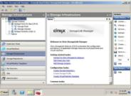

Citrix Integrated Storage Management
Citrix
XenCenter
Desktop
Admin
Provisioning
Backup
Recovery
Deduplication
Cloning
DR
XenDesktop
Citrix StorageLink
NetApp
Virtualized Storage
Integrates
advance storage
features at
policy level
Notes:
101
Goal of this slide: “Single-pane-of-Glass” Management
Key Points:
Tight integration of NetApp storage with Citrix StorageLink and XenDesktop enables administrators to access and execute advanced storage functions directly from the XenDesktop console.
This integration streamlines storage administration because it empowers XenDesktop administrators to manage storage within existing storage policies without having to coordinate with storage administrators.
Storage admin sets policy
Desktop admin has capability – within policy - to use advance storage features (i.e., backup, cloning, resizing…)
Accessible from familiar management console

Slide 102
Cloud
Shared Infrastructure

Slide 103




Unified Connect Infrastructure
Today
FC
CNA
FCoE, iSCSI, NFS, CIFS
10GbE Switch (FCoE Enabled)
FC
NFS, CIFS, iSCSI
FCoE
10GbE
FC
UTA
Notes:
With the mix workloads customers have had to create many different connection layers to converse between the servers and storage.

Slide 104
Unified Connect Infrastructure
With Unified Connect
Key Feature Benefits
True end-to-end network conversion
Increased efficiency and simplified management
Extend the unified architecture benefits
CNA
FCoE, iSCSI, NFS, CIFS
10GbE Switch (FCoE Enabled)
Business Value
FCoE
Streamlining of IT operations, resulting in lower operating costs
Data center consolidation a true reality
Ability to react to market demands faster
10GbE
FC
UTA
UTA : Unified Target Adapter
Notes:
Unified Connect allows all protocols to run over the Unified Target Adapter (UTA). There is no need for separate cards, separate FC switches as everythng can be run over ethernet and allows customers to fully consolidate their IT environment. We are the only storage vendor to offer this and as such a leader in helping customers consolidate their environments.

Slide 105



